Slide 1
Social Data Science Lesson #3
Rasmus W. Schmøkel, University of Southern Denmark
Fall 2022

Slide 2
Overview
Lesson #1 - Introduction to the course & Data Science as a field
Lesson #2 - Programming Fundamentals
Lesson #3 - Data Science Fundamentals
Lesson #4 - Working with API’s
Lesson #5 - Network Analysis
Lesson #6 - Webscraping in R
Lesson #7 - Text as data: Who say’s what and why?
Lesson #8 - Machine Learning 1
Lesson #9 - Machine Learning 2
Lesson #10 - Machine Learning 3 & finale remarks

Slide 3
Today’s lesson
Last time
Data Import
Data Exploration & Wrangle
Ggplot2

Slide 4
Today’s lesson
Last time
Data Exploration & Wrangle
Wrangle
Logic and build-up of pipes.
walk-through of most used functions
Filter, summarize, mutate, select find the rest
Join types
Ggplot2
Logic & walkthrough of ggplot2 package

Slide 5
Recap as warm up!

Slide 6
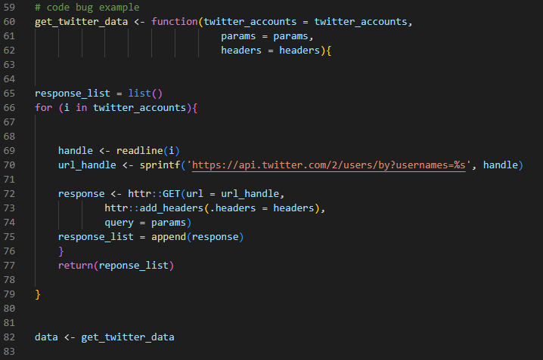

Slide 7
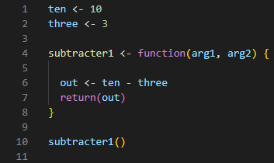
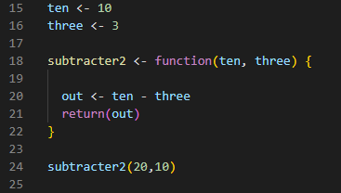

Slide 8
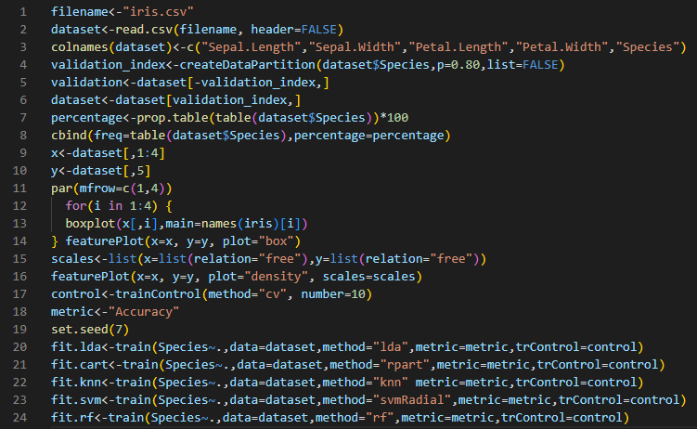

Slide 9
Data import

Slide 10
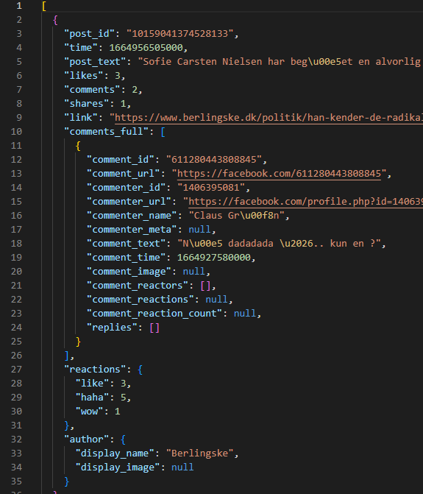
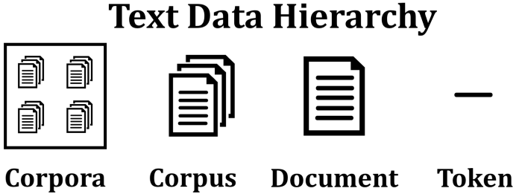
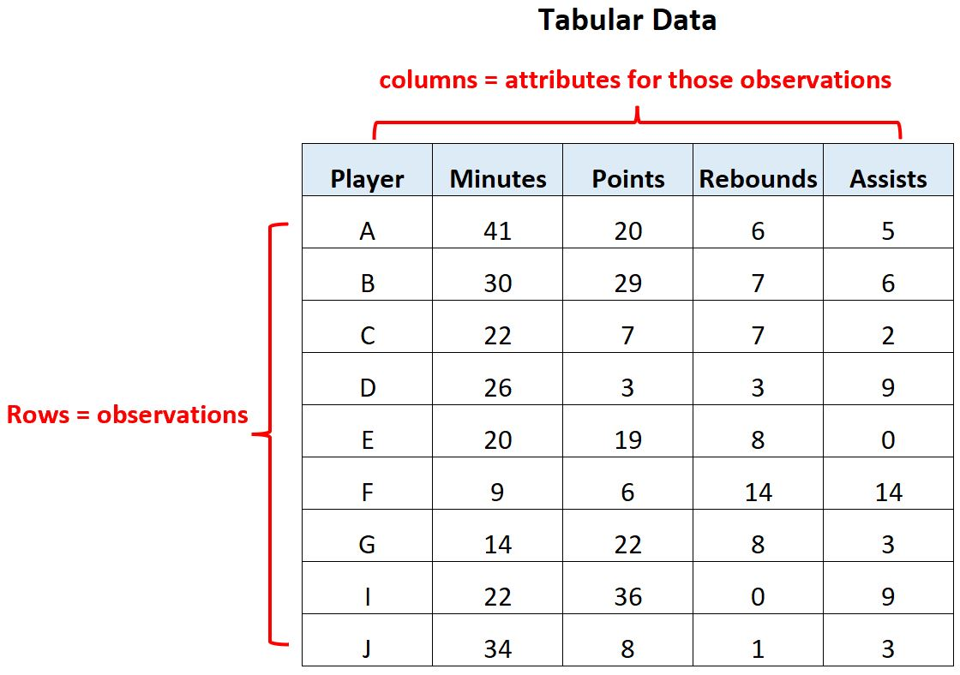
Contextualizing Data structures
JSON
Text as data
Tabular

Slide 11
Importing data
Loading flat files with:
read.csv() or read_csv()
read.csv() or read_csv2()
Tidyverse (readr) versions of base R

Slide 12
Importing data
Even flat files e.g. .csv-files looks very different and cause a lot of troubles
Be aware when importing!
And again – you’re not supposed to remember code, e.g. functions, from the top of your head
Google
See the documentation
Stackoverflow.com
AND USE TODAYS READINGS AS REFERENCE (both required and optional readings)

Slide 13
Data Exploration & Wrangling

Slide 14
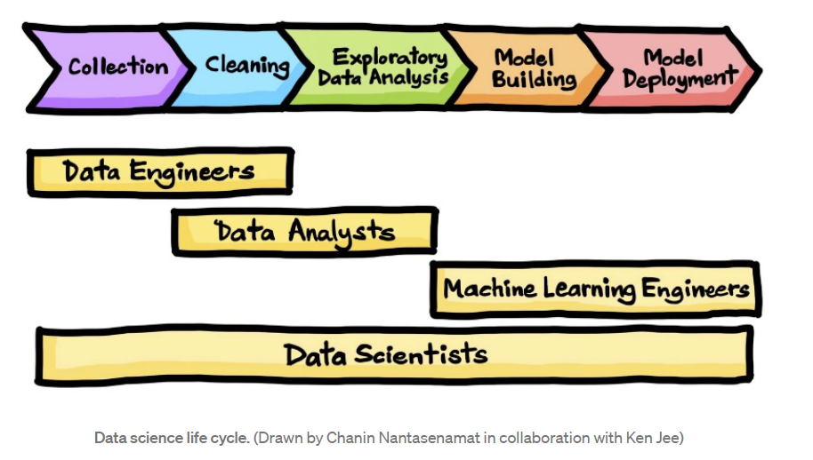
Data Exploration & wrangle
80%!

Slide 15
Exploratory Data Analysis
Generate questions about your data.
Search for answers by visualising, transforming, and modelling your data.
Use what you learn to refine your questions and/or generate new questions
Source: r4ds

Slide 16
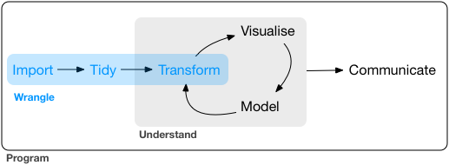
Exploratory Data Analysis
Generate questions about your data.
Search for answers by visualizing, transforming, and modelling your data.
Use what you learn to refine your questions and/or generate new questions
Source: r4ds

Slide 17
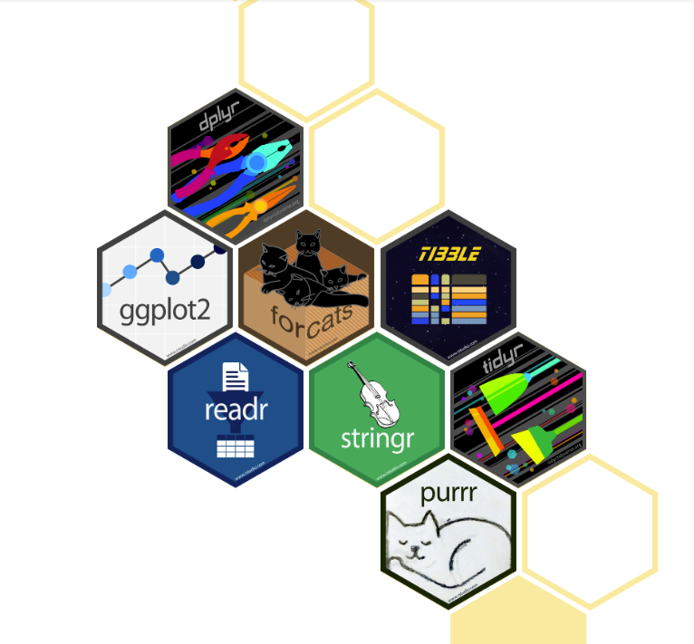
Introduction to Tidyverse

Slide 18
Handy explore and wrangling functions in Tidyverse
A very handy set of functions and operations for data analysis!
filter()
arrange()
select()
mutate()
summarise()/summarize()
group_by()
Learning them is a hands-on task -> not going through them now
R4DS, Explore.DataTransformation!!!

Slide 19
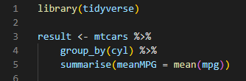
Pipe operators!
Tidyverse (actually magrittr) provides %>%
shortcut: ctrl+shift+m
Can be interpreted as “and then”

Slide 20
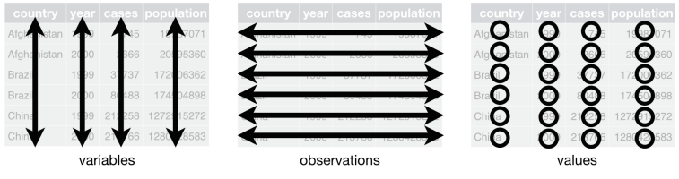
What is Tidy data
As we know (with data frames)
Each variable has its own column
Each observations its won row
Each value has its own cell

Slide 21
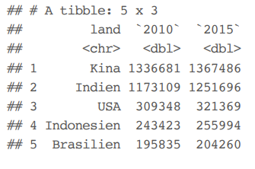
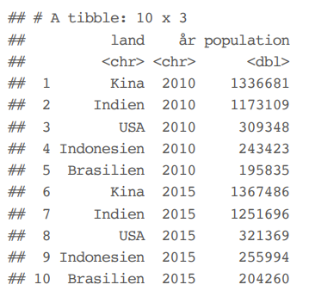
Tidy data 1 Some examples

Slide 22
Tidy data 1 Some examples
Wide to long format
Values in columns -> gather()

Slide 23
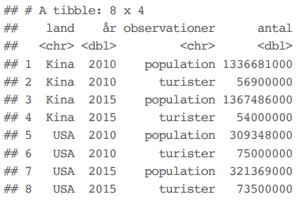
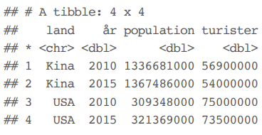
Tidy data 2 Some examples

Slide 24
Tidy data 2 Some examples
Multiple variables in the same column -> spread()

Slide 25
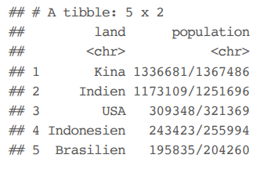
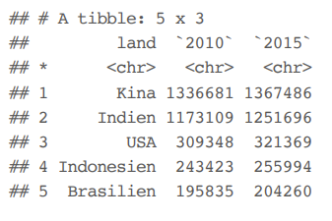
Tidy data 3 Some examples

Slide 26
Tidy data 3 Some examples
If you need to separate values in a cell into two columns -> sperate()
The opposite: unite()

Slide 27
Joins

Slide 28
What is the purpose of joins
Enrich a dataset of database table with another dataset or table
In R4DS they talk about “relational data”.. Which I don’t like
To join properly you need column with unique values -> an identifier column
Primary keys and foreign keys
Sometimes the data is designed to be joined.. More often than not, it is not and you need to get creative

Slide 29
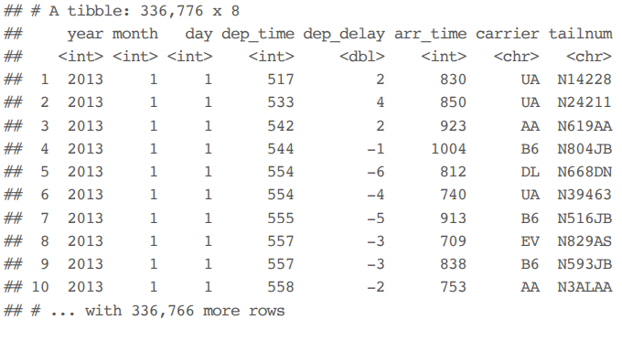
What is the purpose of joins
What could be the primary key in the built-in ‘flights’-dataset?

Slide 30
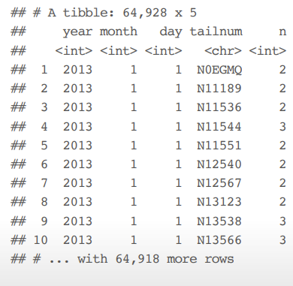
What is the purpose of joins
What about the combinations: year, month, day, tailnum
Nope… not unique

Slide 31
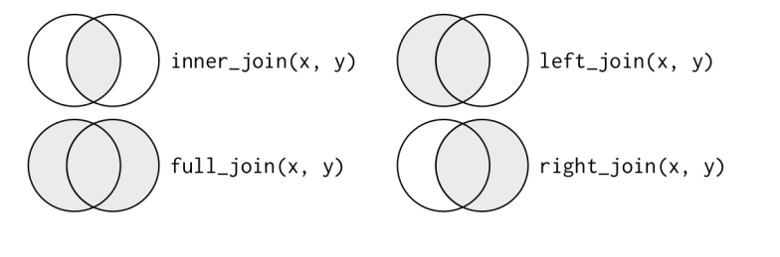
What is the purpose of joins
Source: R4DS

Slide 32
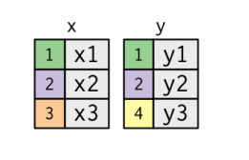
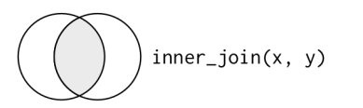
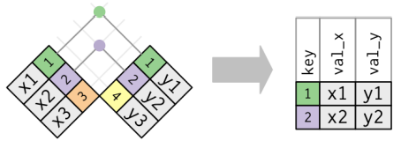
Inner join

Slide 33
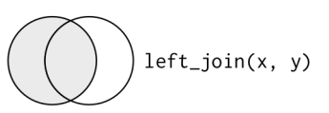
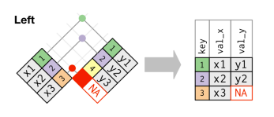
Left join

Slide 34
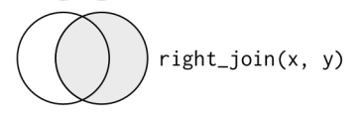
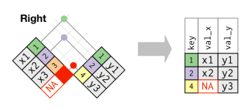
Right join

Slide 35
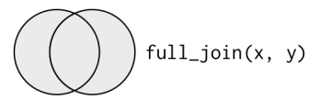
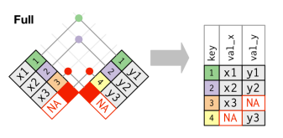
Full join

Slide 36
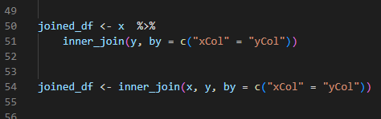
Join coding example

Slide 37
GGPLOT2

Slide 38

GGPLOT2
No. 1 visualization library!
Build up in layers!
Highly customizable
Plots can be saved as objects!
Can also be used with pipe operators

Slide 39
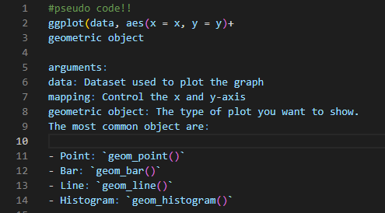
GGPLOT2 SYNTAX

Slide 40
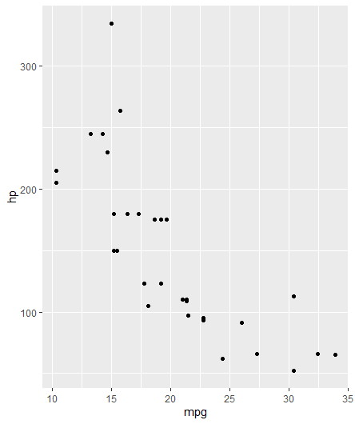

GGPLOT2 SYNTAX

Slide 41
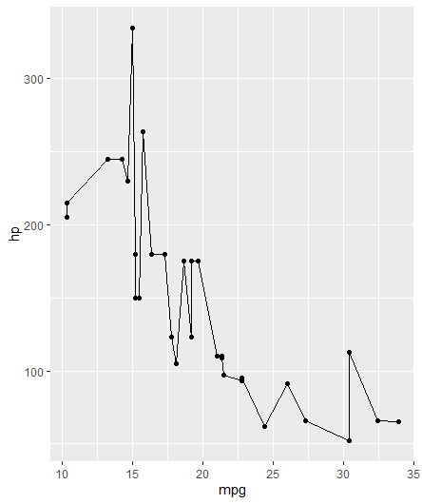

GGPLOT2 SYNTAX

Slide 42
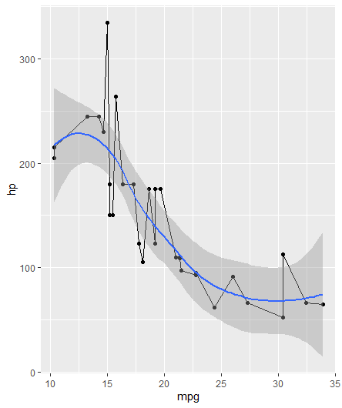

GGPLOT2 SYNTAX

Slide 43
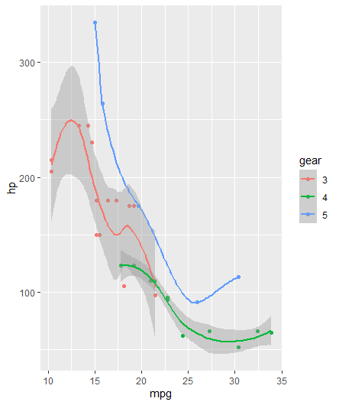
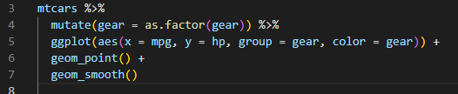
GGPLOT2 SYNTAX

Slide 44
Lab time!

Slide 45
Lab#3 goals
Go through the lab#3 R-notebook!

